Slide 1
Analysis, Design and Development of a Healthcare Patient Information Management System
Group Members:
Akarsha Bohath (999904211)
Pragya Chand (999903841)
Prof: Md Hasanuzzaman

Slide 2
Project Description
The Healthcare Patient Management System (HPMS) enables medical facilities to organize patient information and monitor healthcare activities effectively. Healthcare professionals including Patients, Doctors, Nurses, and System Administrators access the platform continuously. New user complete registration by creating accounts and updating personal information including Username, Date of birth, Email, and Phone Number. Authentication requires valid login credentials with Username and password verification. The platform incorporates comprehensive input validation ensuring data integrity by confirming credential authenticity, proper email formatting, phone validation, and complete patient/appointment data.

Slide 3
Project Description
Patient records, appointments, and prescriptions will be managed by Doctors and Nurses, who can add, update, and track patient history and treatment details. These updated records will be used to generate patient summaries and appointment schedules. All user and patient data will be stored in a database. Users can log in at any time to view personal records, upcoming appointments, prescriptions, and medical history. They can also update their profiles and track interactions with medical staff. Authorized Doctors, Nurses, and Administrators can run the application and generate comprehensive reports including patient visits, treatment statistics, prescription history, and billing information in PDF format, which can be reviewed and distributed for hospital management and auditing purposes.

Slide 4
List of stakeholders
Active Stakeholders
Patients : Register, book appointments, view records
Doctors: Manage patient records, prescribe treatments
Nurses: Update records, assist in patient care
System Administrators: Ensure system functionality, reports
Passive Stakeholders
Hospital Management: who do not work in the system
Insurance Providers: Insurance providers who need patient records

Slide 5
List of the major functions/processes
User Registration (All Users)
Login & Authentication (All Users)
Profile Management (All Users)
Appointment Management (Patient, Doctor, Nurse)
Patient Record Management (Doctor, Nurse)
Prescription Management (Doctor)
Report Generation (Doctor, Nurse, Admin)
User management and Administration (Admin)

Slide 6
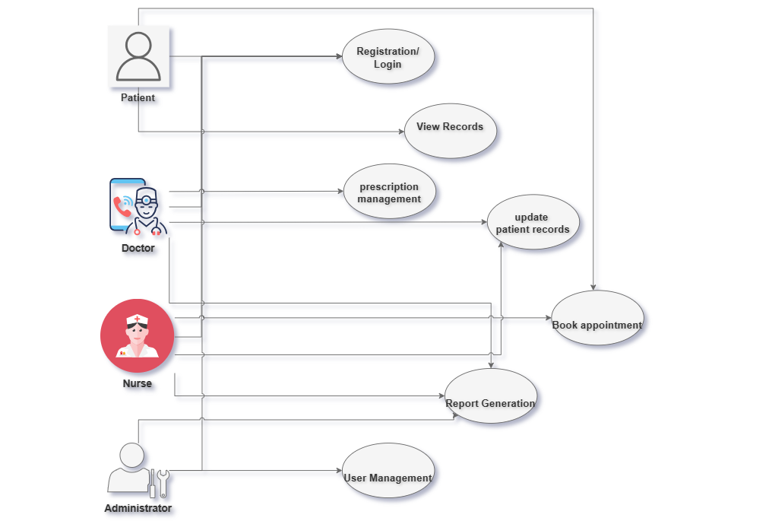
Use Case Diagram for all active Stakeholders

Slide 7
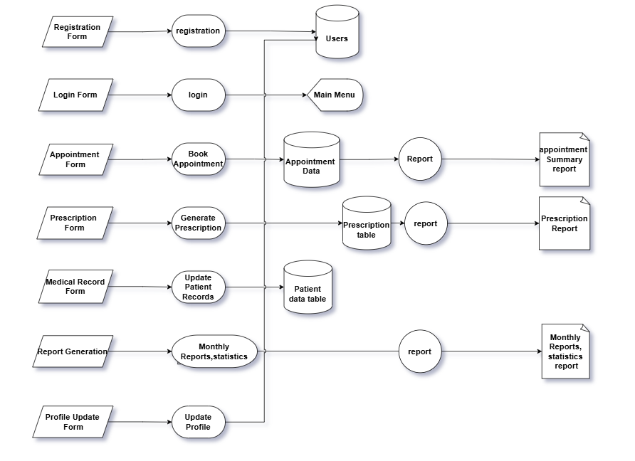
Level-2 Data flow diagram

Slide 8
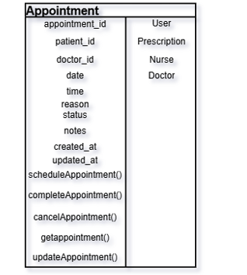
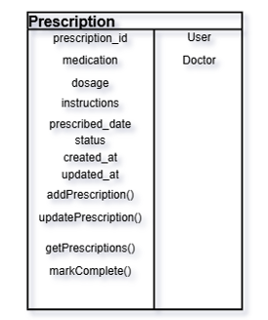
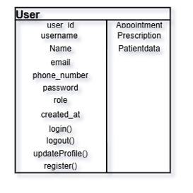
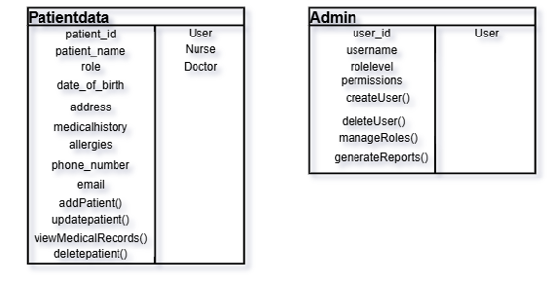
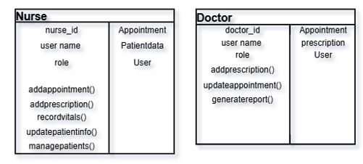
CRC Model diagrams

Slide 9
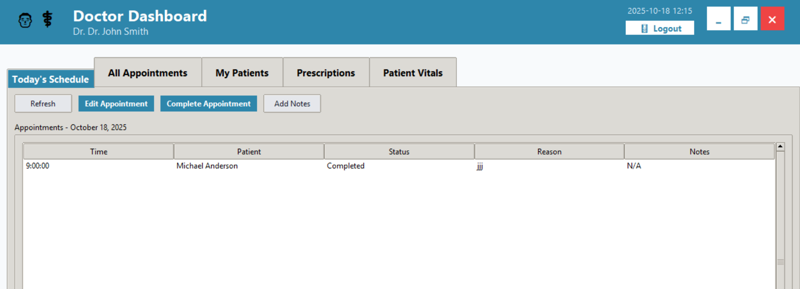
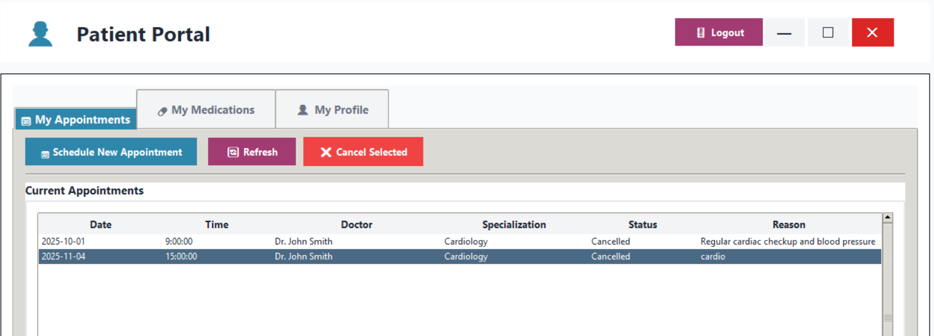
Dashboard or Landing screens

Slide 10
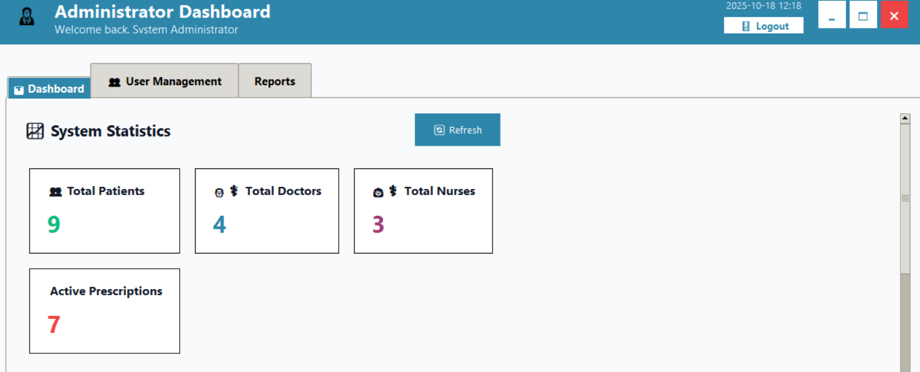
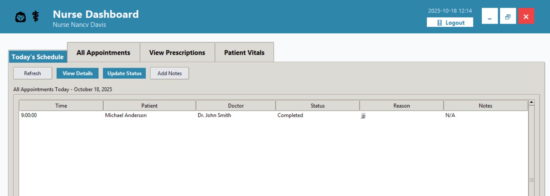
Dashboard or Landing screens

Slide 11
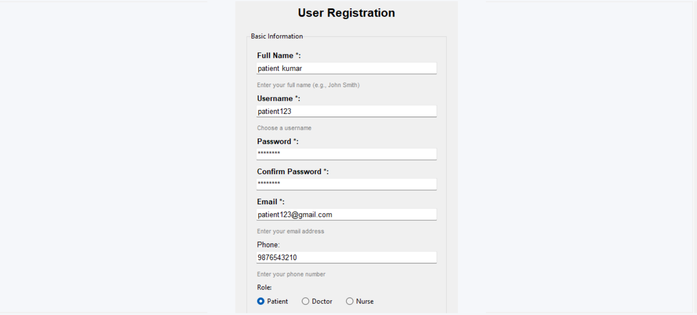
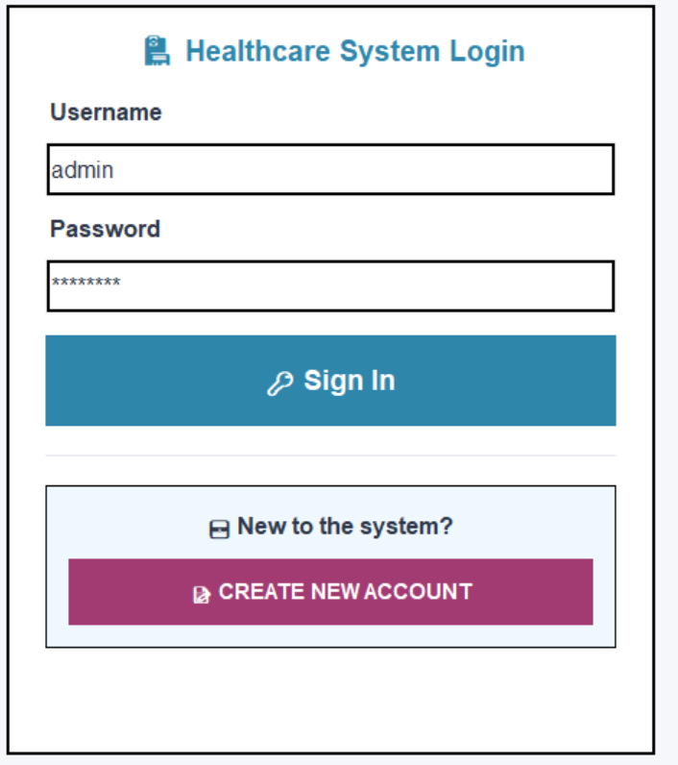
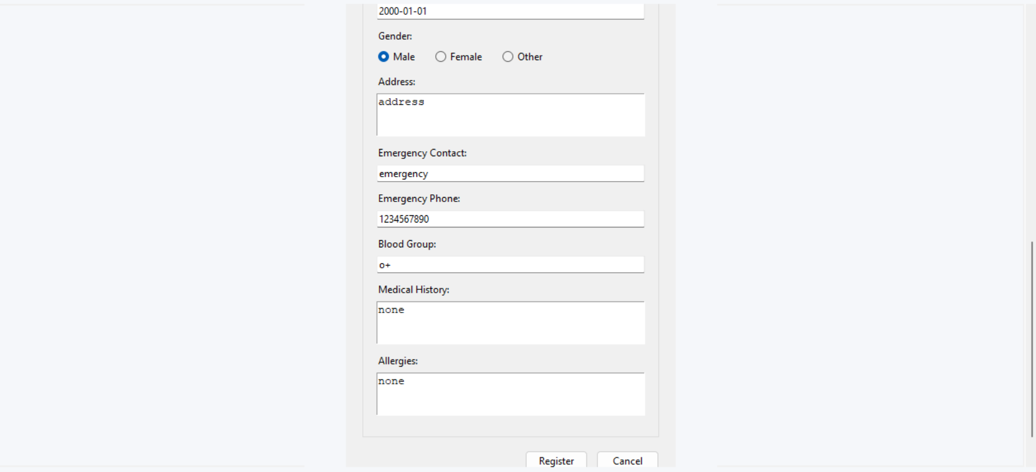
All the User interfaces
User Registration and Login Interfaces

Slide 12
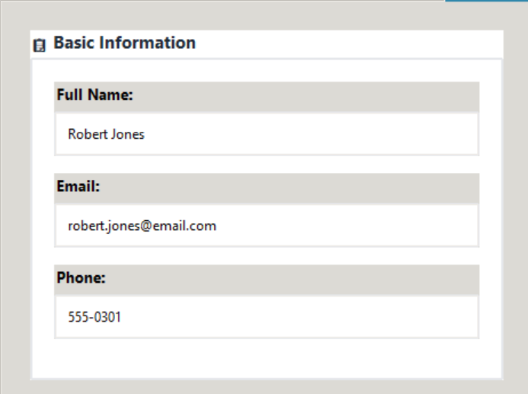
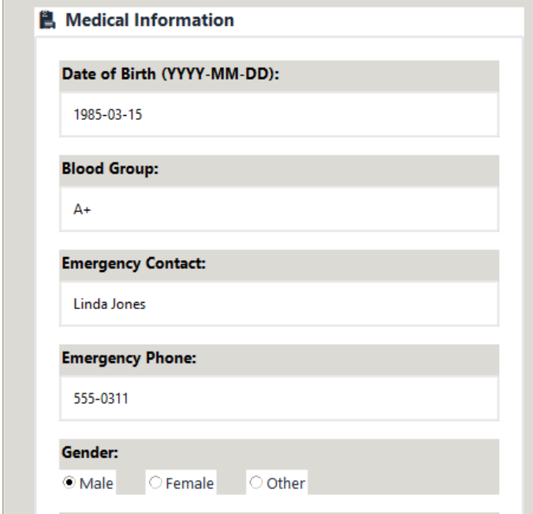
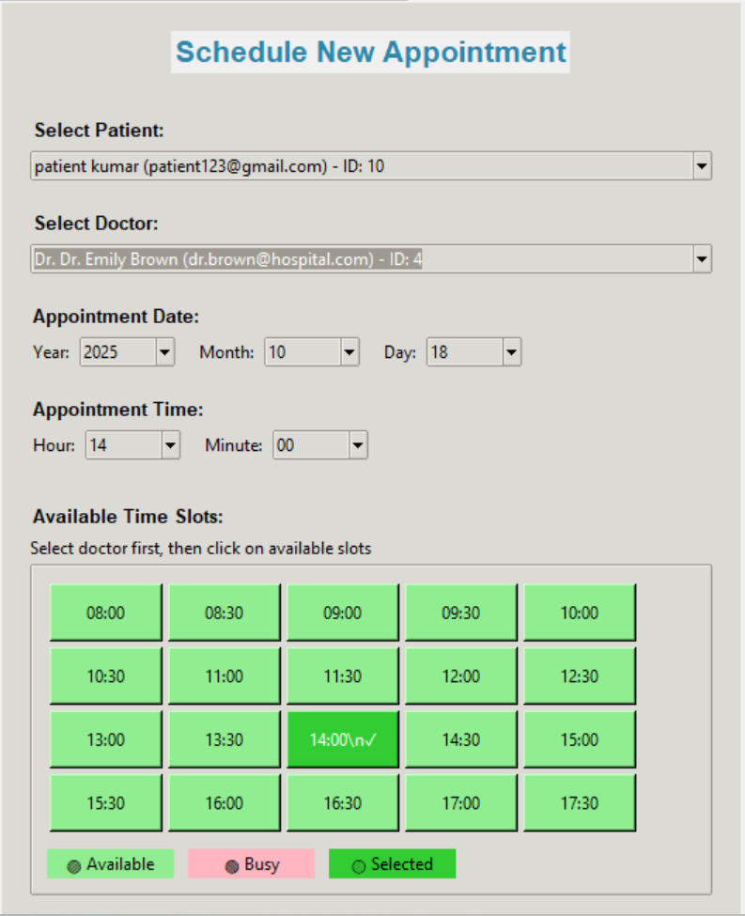
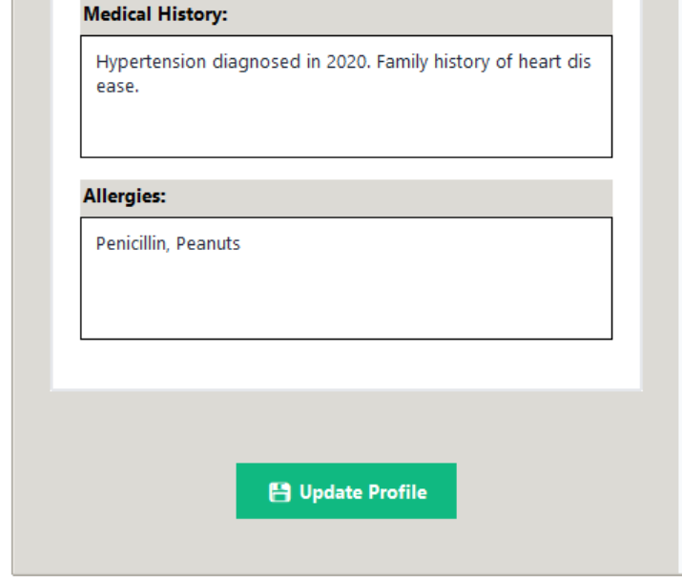
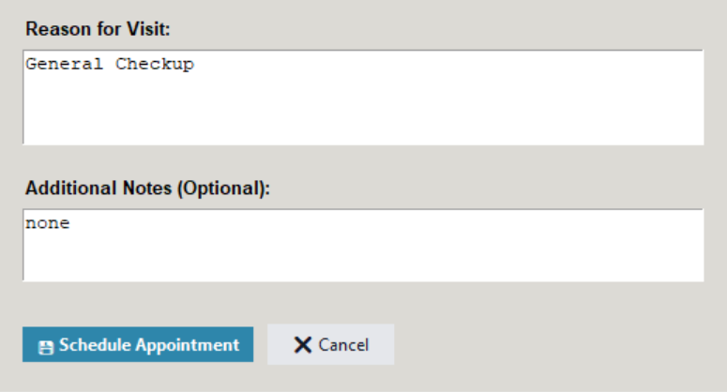
All the User interfaces
User information update and scheduling new appointment interfaces

Slide 13
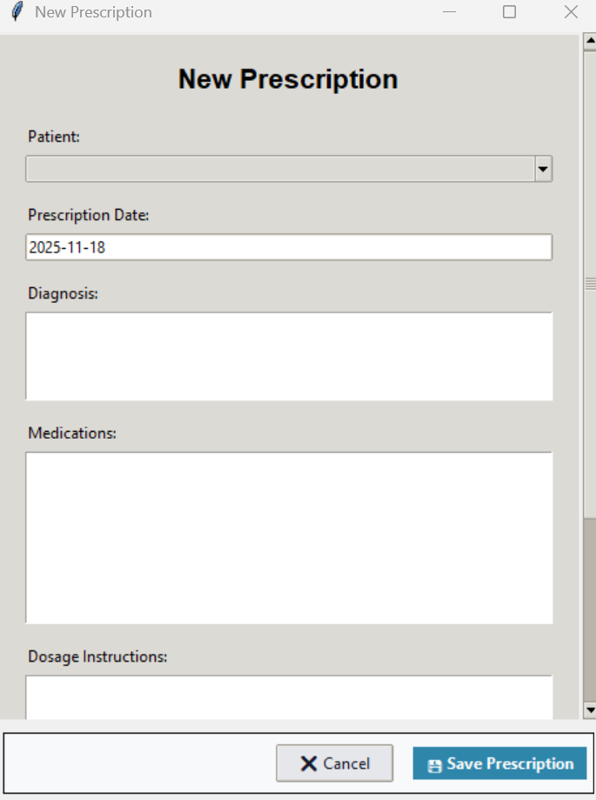
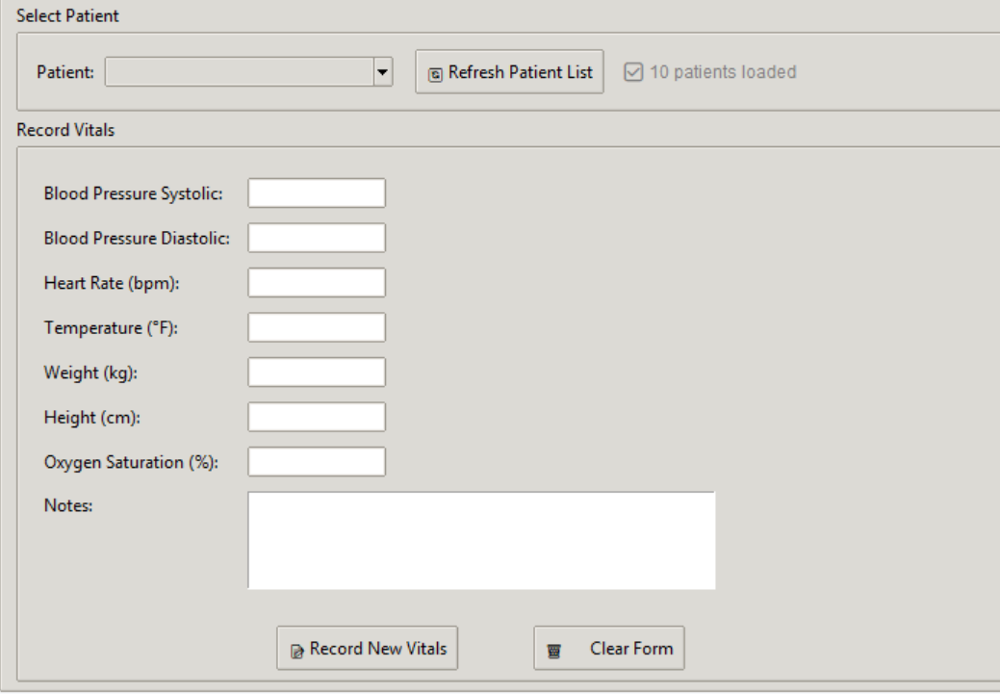
All the User interfaces
Patient vitals update by Nuse and New prescription by Doctor interfaces

Slide 14
All the file designs
1.Name of the file: users Description : Stores core user account information for all system roles Number of Fields : 10 Primary Key : user_id Foreign Keys : None
Field Name | Description | Data Type | Length
user_id | Unique identifier for each user | INT | 11
username | User’s login name | VARCHAR | 50
password | password | VARCHAR | 255
email | email address | VARCHAR | 100
full_name | Full name | VARCHAR | 100
phone | Contact number | VARCHAR | 15
role | admin, doctor, nurse, patient | ENUM
created_at | Record creation timestamp | TIMESTAMP
updated_at | Record update timestamp | TIMESTAMP
is_active | Indicates if user is active | TINYINT | 1

Slide 15
All the file designs
2. Name of the file: patients_file
Name of the file : patients
Description : Contains personal information of patients linked to their user.
Number of Fields : 12
Primary Key : patient_id
Foreign Keys : user_id
Field Name | Description | Data Type | Length
patient_id | Unique patient identifier | INT | 11
date_of_birth | Date of birth | DATE
gender | Gender of patient | ENUM
address | Residential address | TEXT
emergency_contact | Emergency contact person | VARCHAR | 100
emergency_phone | Emergency contact number | VARCHAR | 15
blood_group | Blood group | VARCHAR | 5
medical_history | Medical history details | TEXT
allergies | Known allergies | TEXT
created_at | Record creation timestamp | TIMESTAMP
updated_at | Record update timestamp | TIMESTAMP
user_id | References users | INT | 11

Slide 16
All the file designs
3. Name of the file: appointments Description : Tracks scheduled, completed, and cancelled appointments between patients and doctors. Number of Fields : 10 Primary Key : appointment_id Foreign Keys :patients(patient_id)
doctors(doctor_id)
Field Name | Description | Data Type | Length
appointment_id | Unique appointment identifier | INT | 11
appointment_date | Date of appointment | DATE
appointment_time | Time of appointment | TIME
status | Appointment status | ENUM
reason_for_visit | Reason for consultation | TEXT
notes | Additional remarks | TEXT
created_at | Record creation timestamp | TIMESTAMP
updated_at | Record update timestamp | TIMESTAMP
patient_id | References patients | INT | 11
doctor_id | References doctors | INT | 11

Slide 17
All the file designs
4)Name of the file: prescriptions_file
Description: Stores prescriptions issued by doctors for patients.
Number of Fields: 8 Primary Key: prescription_id Foreign Keys: patient_id → patients_file.patient_id, doctor_id → doctors_file.doctor_id
Field Name | Description | Data Type | Length
prescription_id | Unique ID for each prescription | INT
patient_id | Link to patients_file | INT
doctor_id | Link to doctors_file | INT
medication | Medication prescribed | VARCHAR | 100
dosage | Dosage details | VARCHAR | 50
instructions | Instructions for medication use | TEXT
prescribed_date | Date prescription was issued | DATE
status | Prescription status (Active/Completed/Cancelled) | ENUM
created_at | Record creation timestamp | TIMESTAMP

Slide 18
All the file designs
5) Description: Stores doctor-specific details linked to the users table. Number of Fields: 5 Primary Key: doctor_id Foreign Keys: user_id → users_file.user_id
Field Name | Description | Data Type | Length
doctor_id | Unique ID for each doctor | INT
user_id | Link to users_file | INT
specialization | Doctor specialization | VARCHAR | 100
license_number | License number of doctor | VARCHAR | 50
created_at | Record creation timestamp | TIMESTAMP

Slide 19
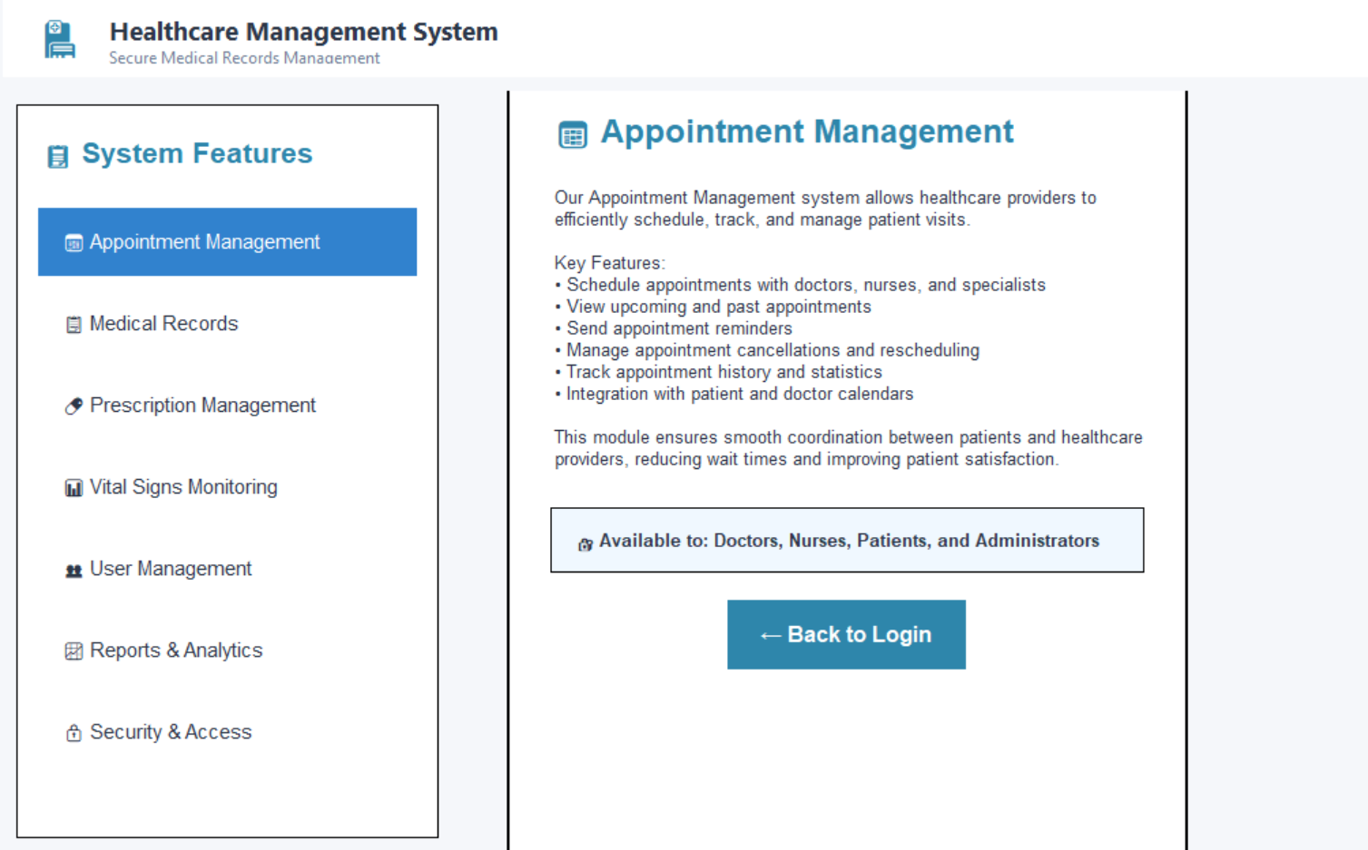
All report or output designs
User can view the features before login , clickable System Features links

Slide 20
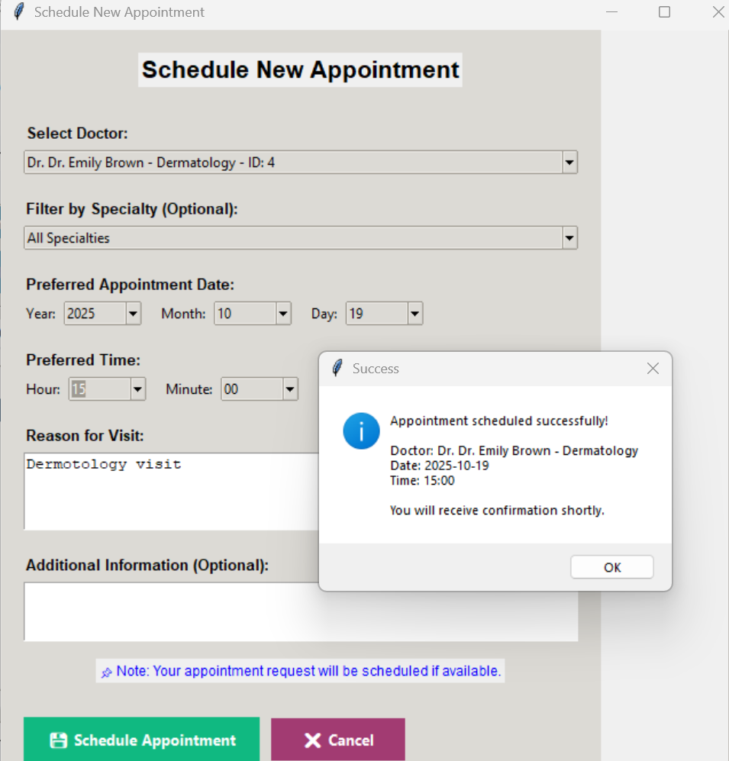
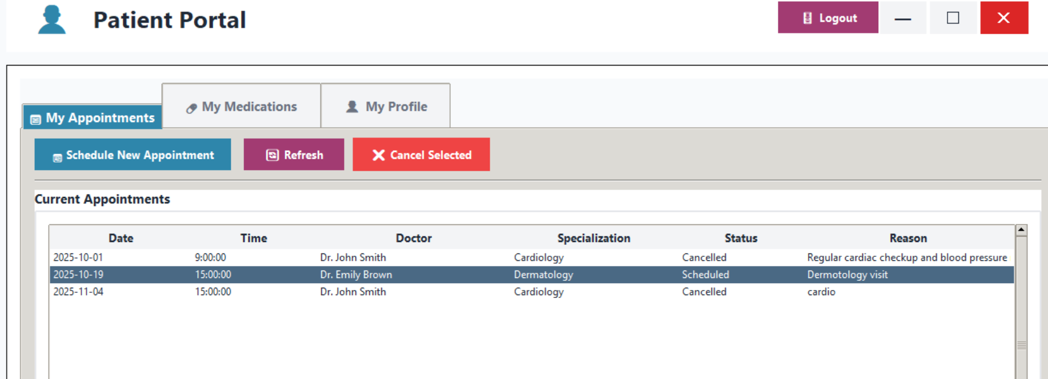
All report or output designs
Scheduling the appointment
Data shown in patient portal for schedule appointment

Slide 21
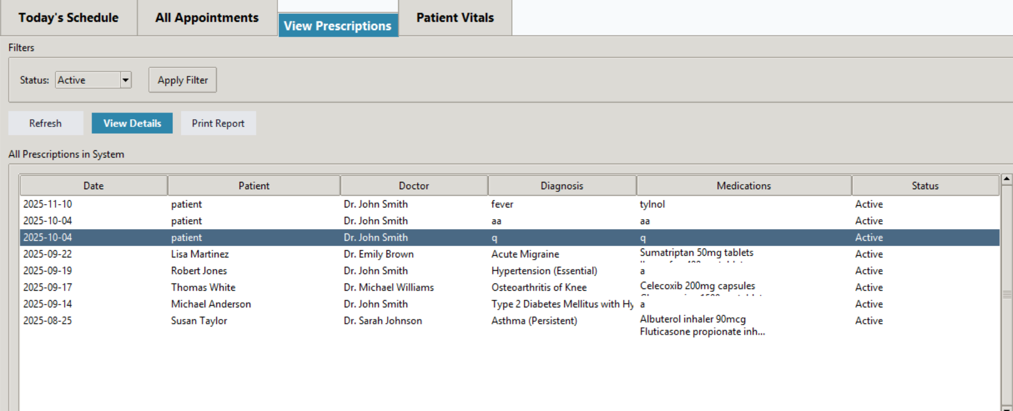
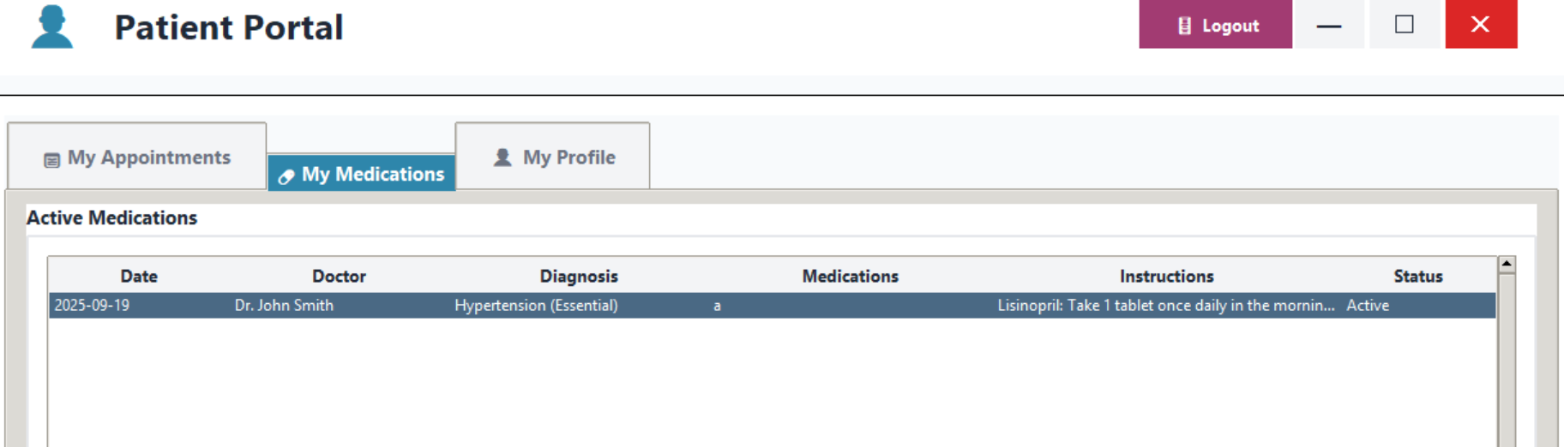
All report or output designs
Nurse/Doctor view of patient Prescription
Patient medication seen

Slide 22
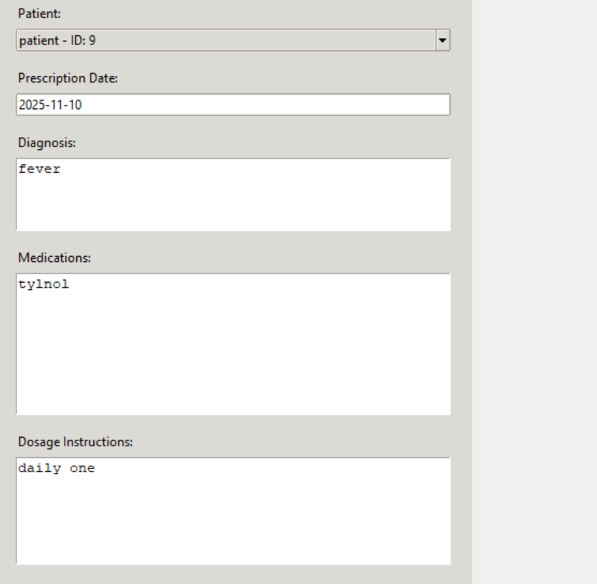
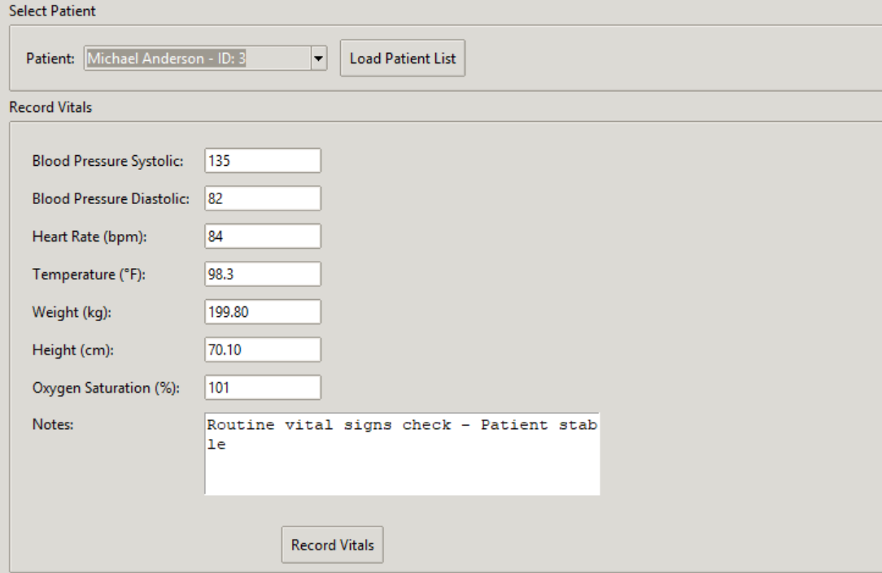
All report or output designs
Doctor Prescription
Vitals recording

Slide 23
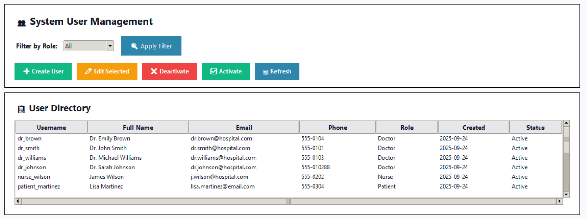
All report or output designs
Admin User management

Slide 24
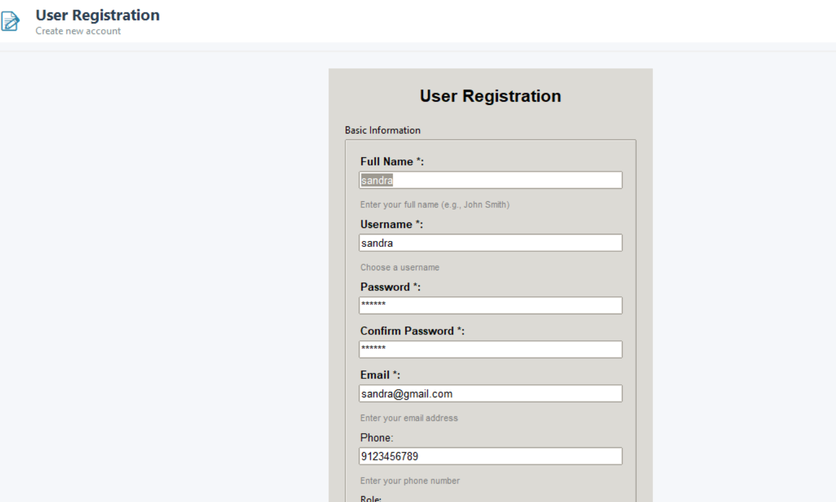
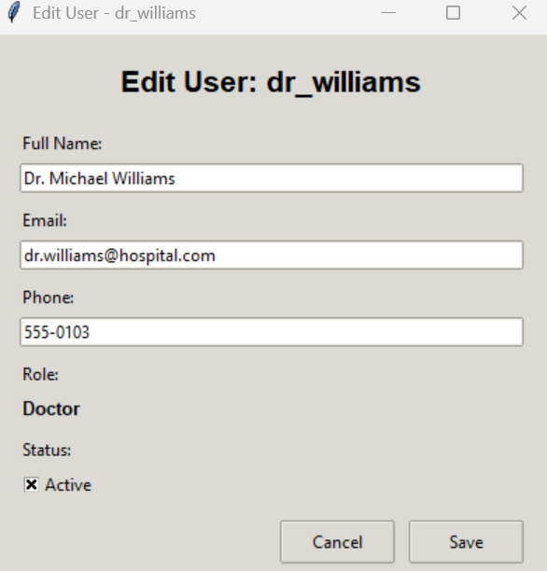
All report or output designs
Admin can register users
Admin can edit the user

Slide 25
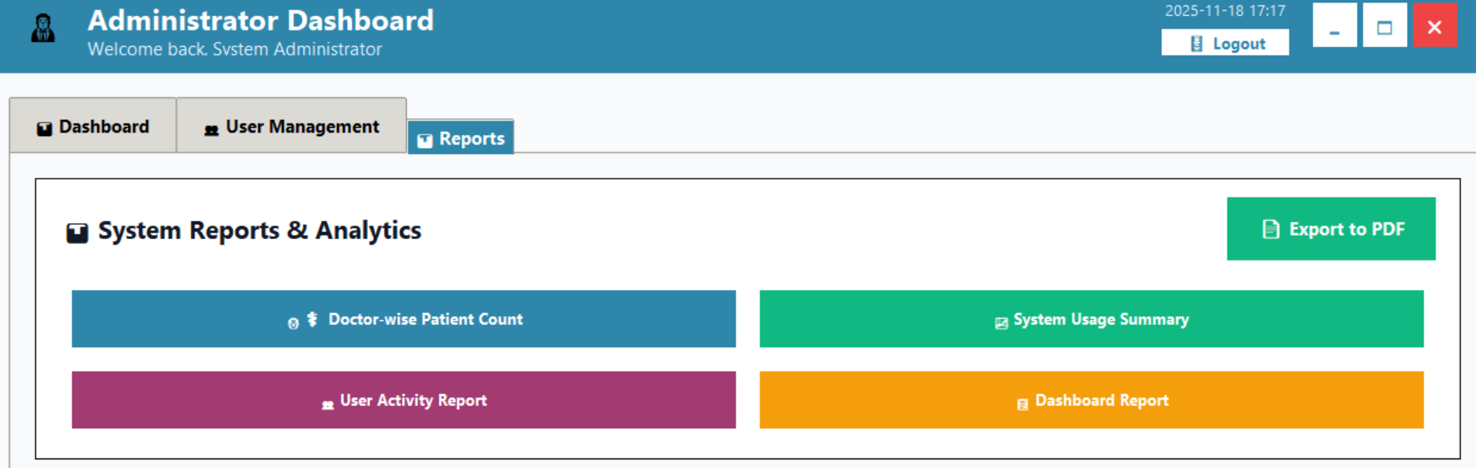
All report or output designs
Reports page design

Slide 26
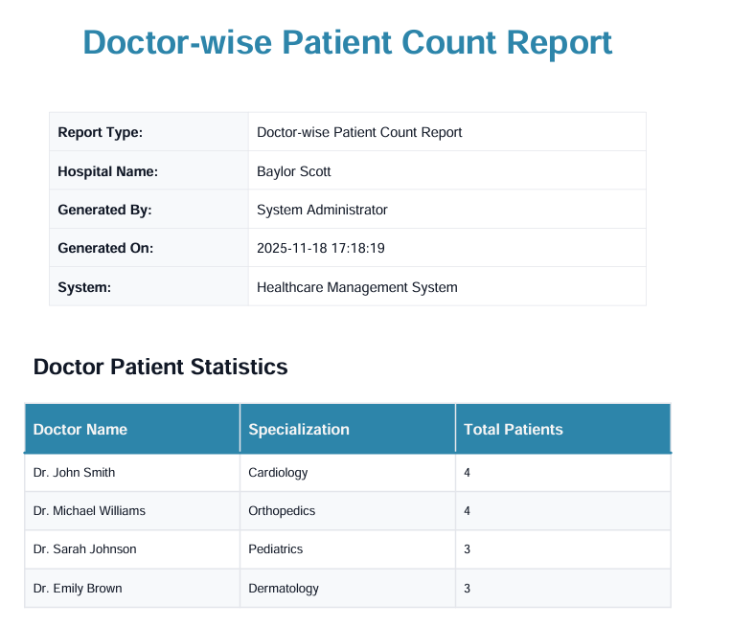
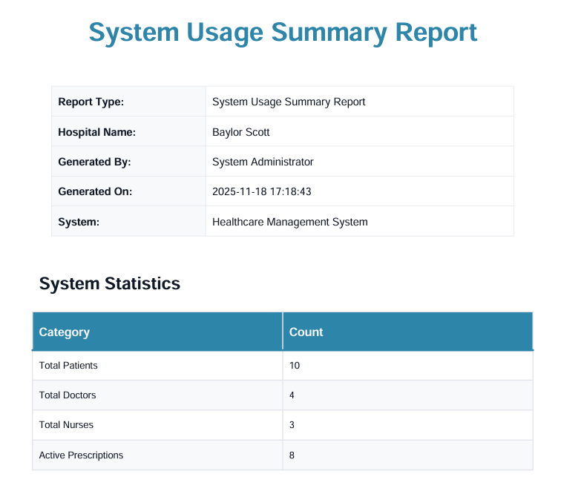
All report or output designs

Slide 27
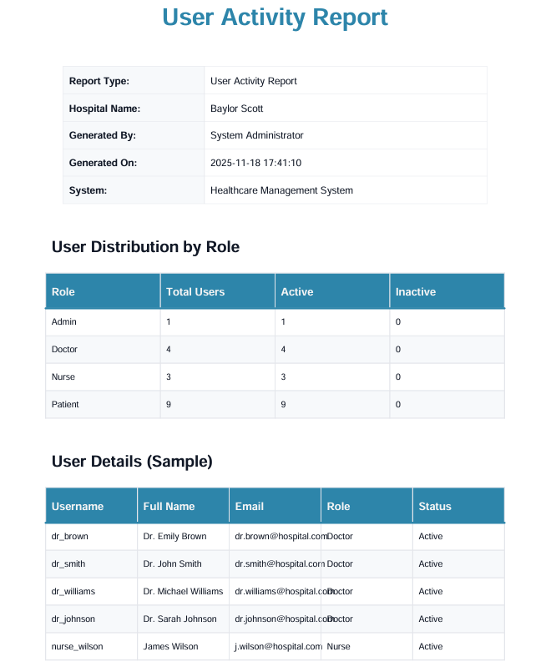
All report or output designs

Slide 28
Algorithms of major processes that you already developed
Algorithm 2: Login Functionality
Start.
User enters username and password.
System verifies credentials against users table.
If match found → check role.
Else → show Invalid Login Error and return to login form.
If role = Patient → redirect to Patient Dashboard.
If role = Doctor → redirect to Doctor Dashboard.
If role = Nurse → redirect to Nurse Dashboard.
If role = Admin → redirect to Admin Dashboard.
End.
Algorithm 1: Account Creation
Start.
User enters registration details (username, email, password, role, etc.).
System validates input fields.
If username/email already exists → show error and return to form.
Else proceed.
Insert new user record into users table.
Display success message.
Redirect user to Login Page.
End.

Slide 29
All report or output designs
Algorithm 4: Book Appointment
Start.
Patient logs in and selects Book Appointment option.
Patient selects doctor, date, time, and enters reason.
System checks doctor’s availability on selected date/time.
If unavailable → show error and ask for another slot.
Else proceed.
Insert appointment record into appointments table with status = “Scheduled.”
Show confirmation message: “Appointment successfully scheduled.”
End.
Algorithm 3: Patient Registration
Start.
Patient logs in successfully after account creation.
Patient opens Registration Form (DOB, address, allergies, medical history).
System validates input fields.
If invalid → return error and re-enter.
Else proceed.
Save patient data into patients table linked by user_id.
Display confirmation message: “Profile completed successfully.”
End.

Slide 30
All report or output designs
Algorithm 5: Update Appointment Status
start
Doctor/Nurse selects an appointment from list.
Choose action → Complete / Reschedule / Cancel.
Update record in appointments table.
Notify patient (UI confirmation).
end
Algorithm 6: Create Prescription
start
Doctor opens prescription form.
Select patient and input diagnosis, medications, dosage.
Insert record into prescriptions table.
end
Algorithm 7: Record Patient Vitals
start
Nurse selects patient from assigned list.
Enter vitals (BP, temperature, heart rate).
Save entry to vitals table with timestamp.
end
Algorithm 8: Generate Reports (Admin)
start
Admin selects report type (doctor, appointment, patient summary).
Query database using role filters.
Display and export as CSV or printable format.
end

Slide 31
Architectural Tech Stack
Programming Frontend | Python TKinter
Programing Backend | Python
DB | MySQL DB
Versioning | GitHub
Platform | Local Standalone

Slide 32
Thank you

